Slide 1



Fort Cherry School District
2021-2022Audit

Slide 2
Independent Auditor’s Report
Expresses that the Financial Statements fairly represent the financial position of the School District as, and for the year ended, June 30, 2022.
It is a clean opinion. We were able to obtain reasonable justification that the numbers are fairly presented (materially stated).

Slide 3
Management’s Discussion and Analysis (MD&A)
The intent of this discussion and analysis is to look at the District’s financial performance as a whole
  Specific comments regarding Fort Cherry School District
  Often carries more relevance to the average Financial Statement reader than the audit report does
  We do not give an opinion on the MD&A,
  it is simply management’s view point

Slide 4

Pennsylvania School Employees’ Retirement System (PSERS)

Slide 5
Estimated District Liability
PSERS State-wide Net Pension
Liability at 6/30/22: $41.1 Billion
FCSD’s % of Liability: 0.0538%
FCSD’s share of PSERS Liability at 6/30/22: $22.1 Million
Notes:
Need to update with correct years and information

Slide 6
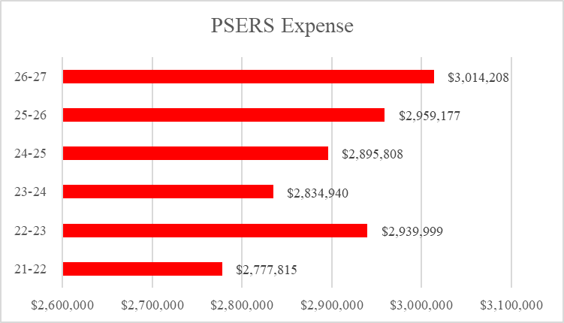
Fort Cherry School District Projected PSERS Expense
(based on 2021-22 actual payroll)
Notes:
UPDATE

Slide 7
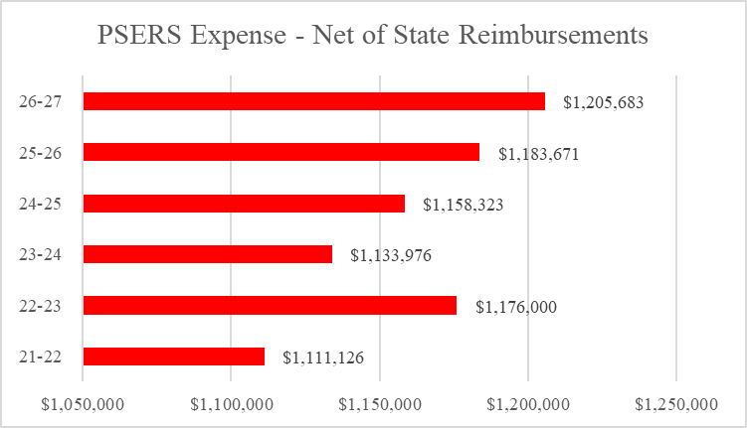
Fort Cherry School District Projected PSERS NET Expense
(based on 2021-22 actual payroll)

Slide 8
Historical Analysis of District Finances

Slide 9
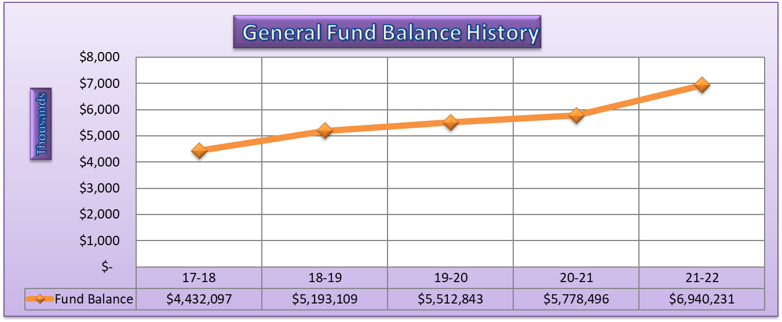
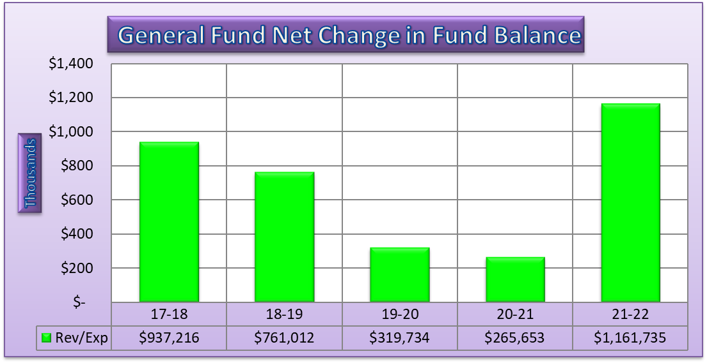

Slide 10
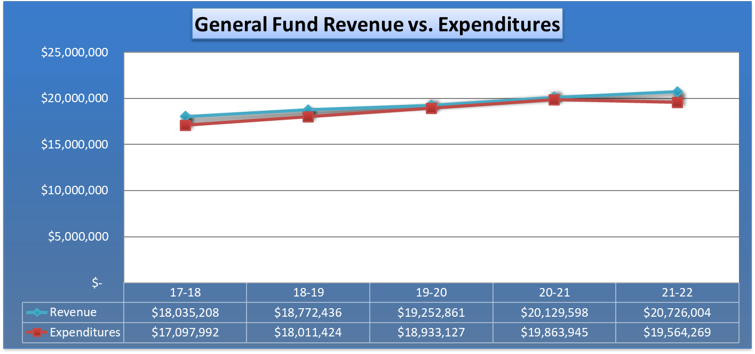
Notes:
Update years and data

Slide 11
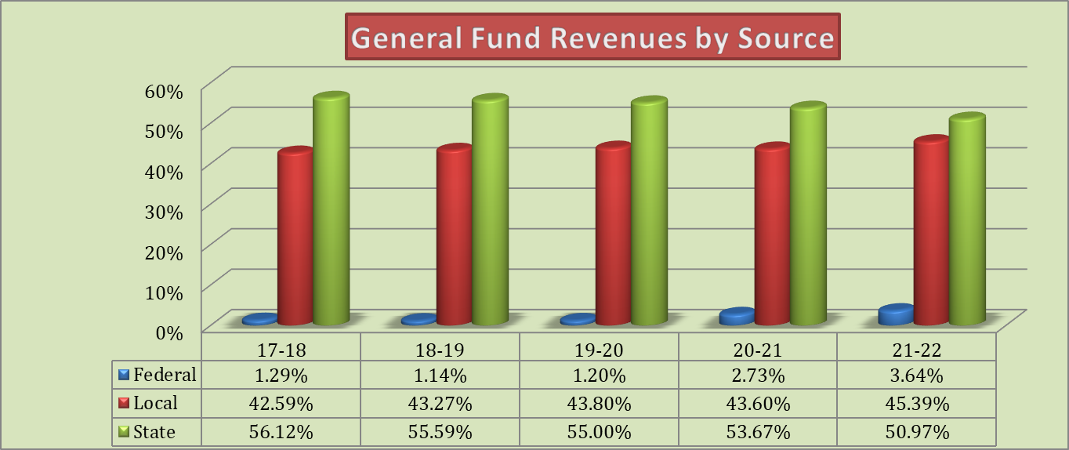
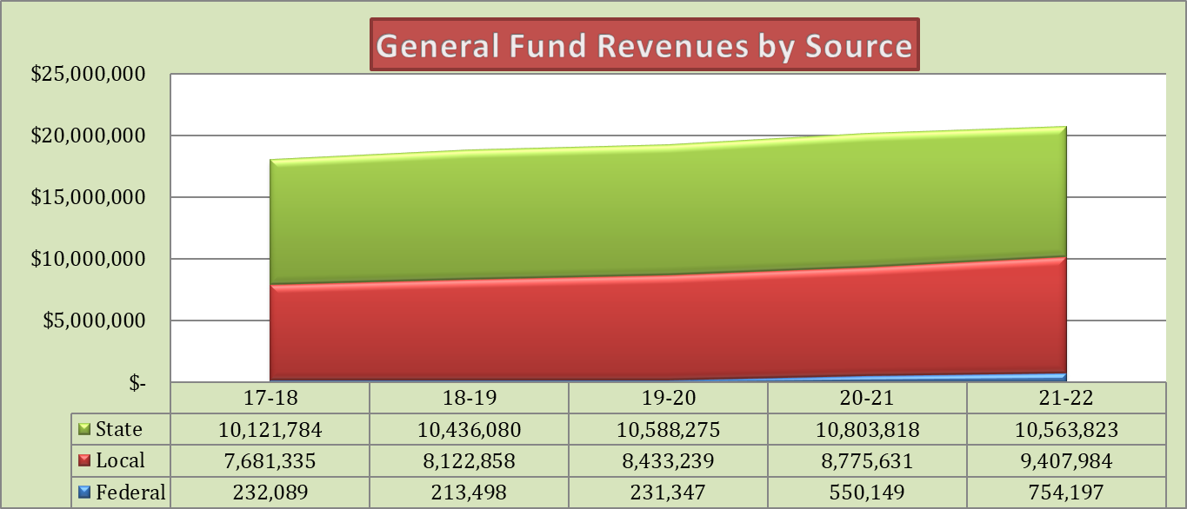

Slide 12
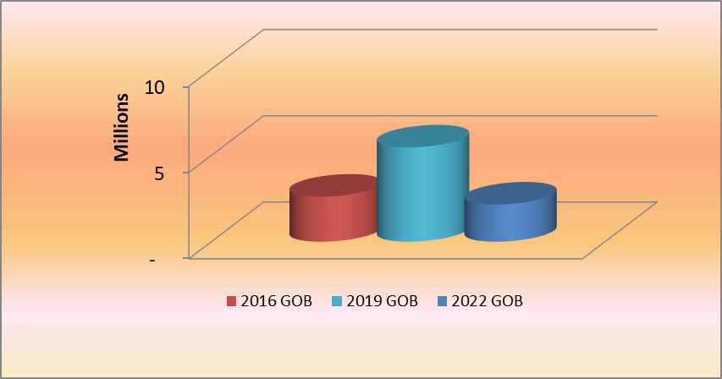
Debt Analysis
Bonds – the District has an outstanding principal balance of $8,075,000
Notes:
Update data

Slide 13
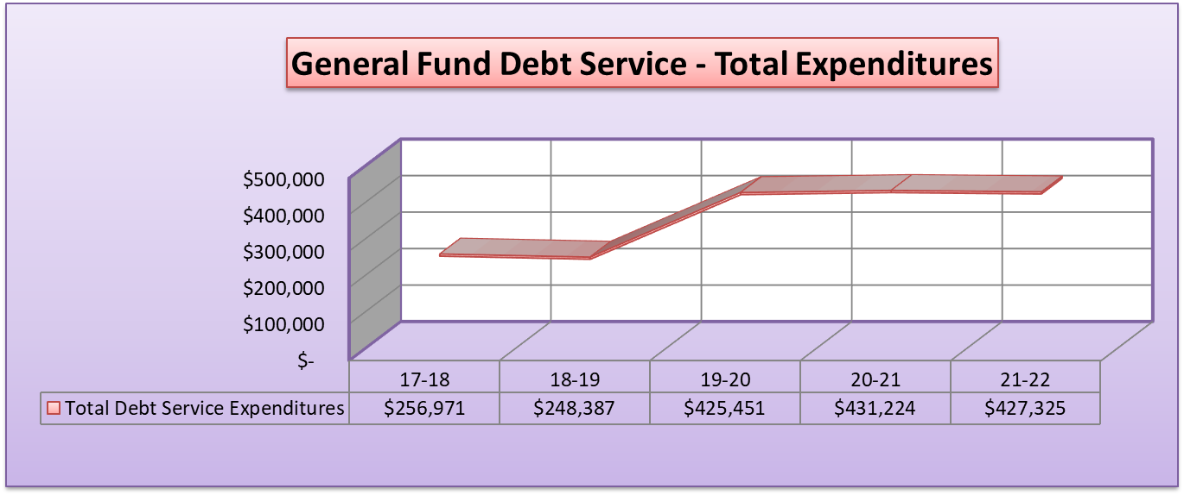
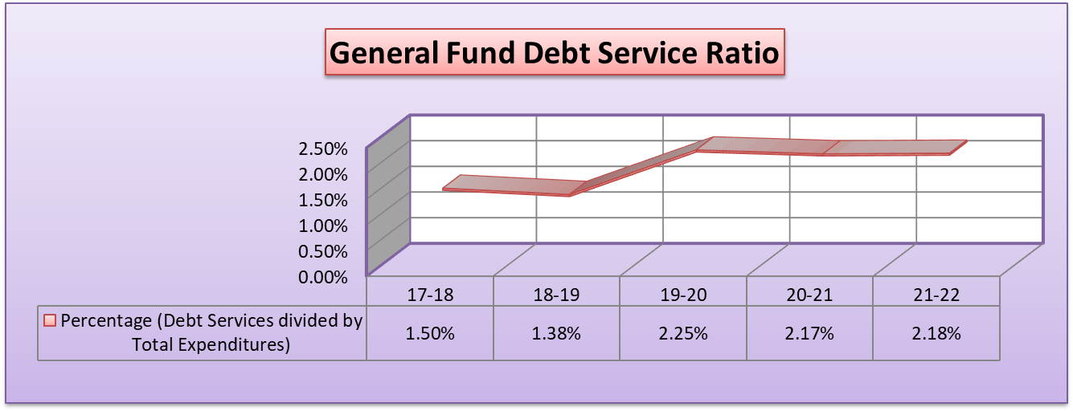
Notes:
Update years and data

Slide 14
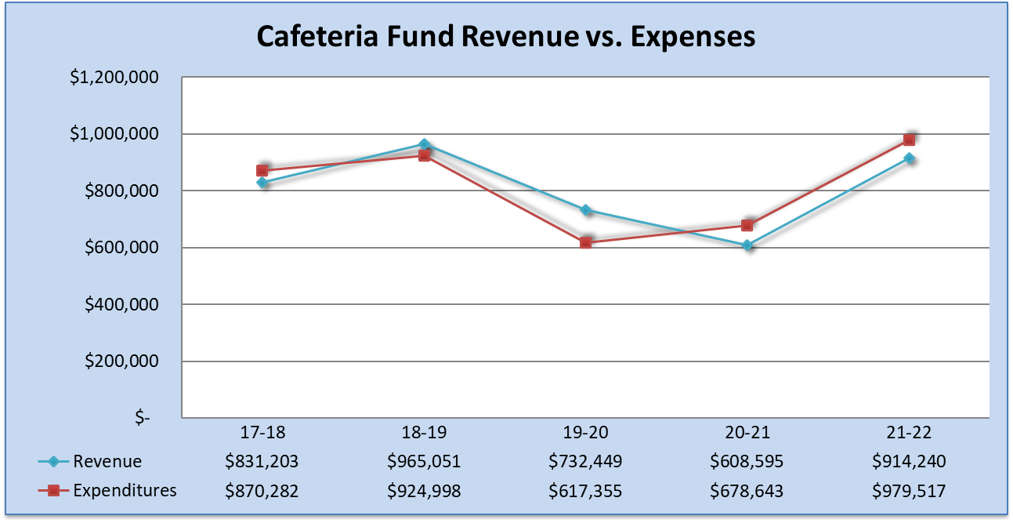
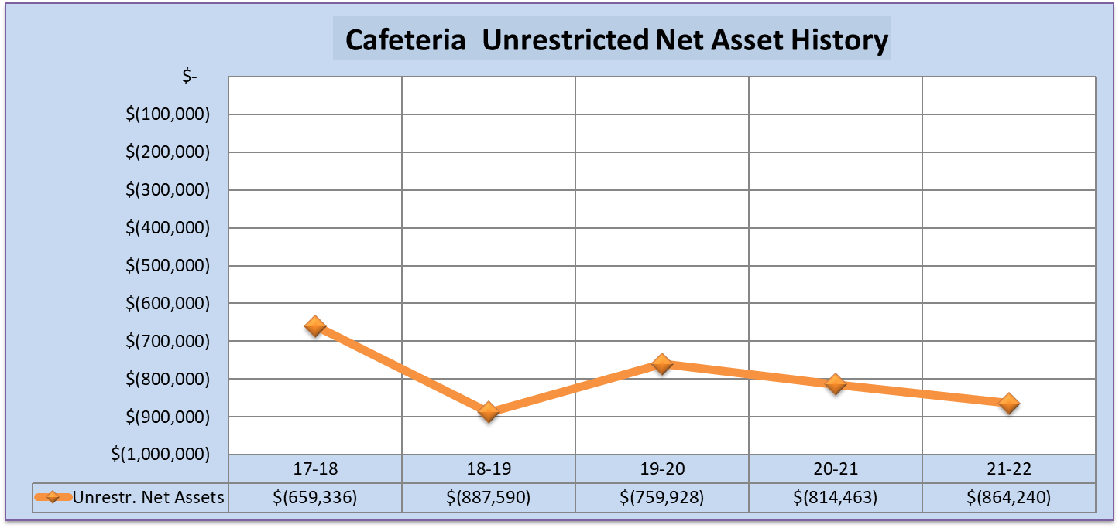
Notes:
Update years and data

Slide 15
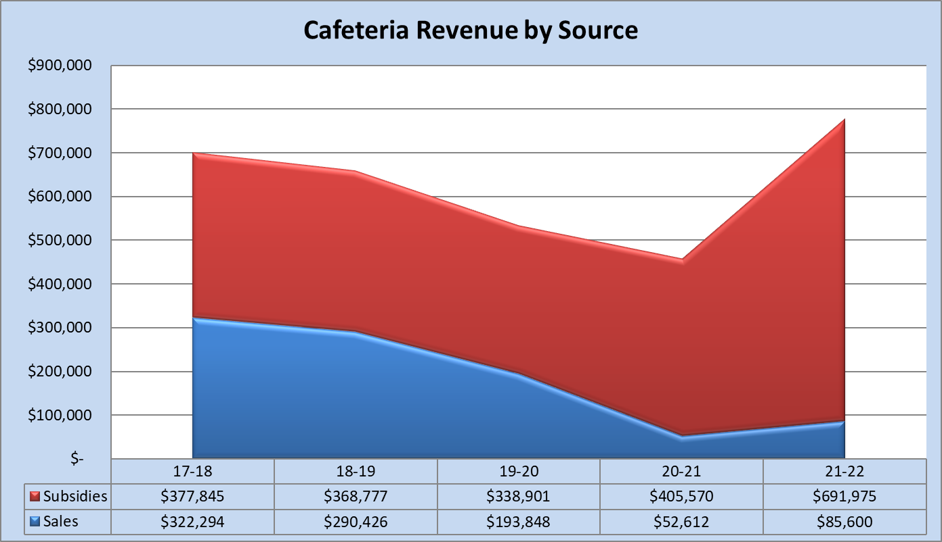

Slide 16
Budget vs Actual

Slide 17
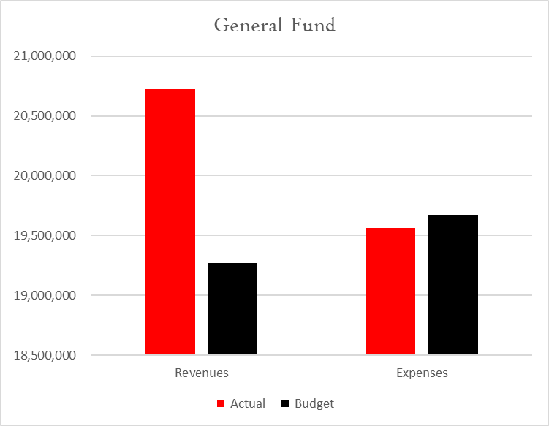
Budget vs Actual - Totals

Slide 18
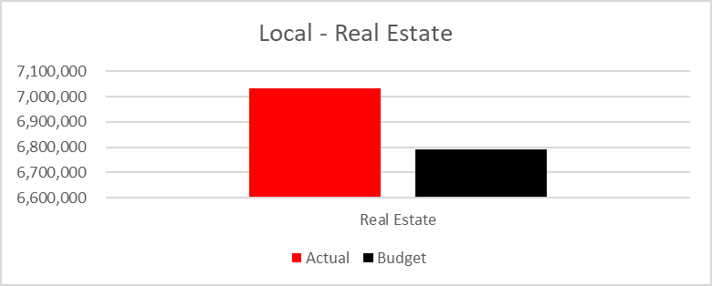
Budget vs Actual
Real Estate Revenue

Slide 19
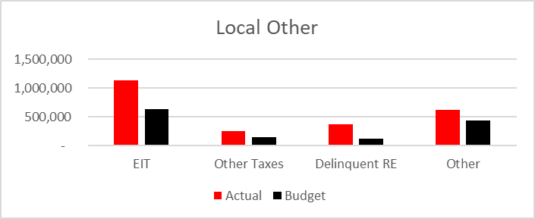
Budget vs Actual
Other Local Revenue

Slide 20
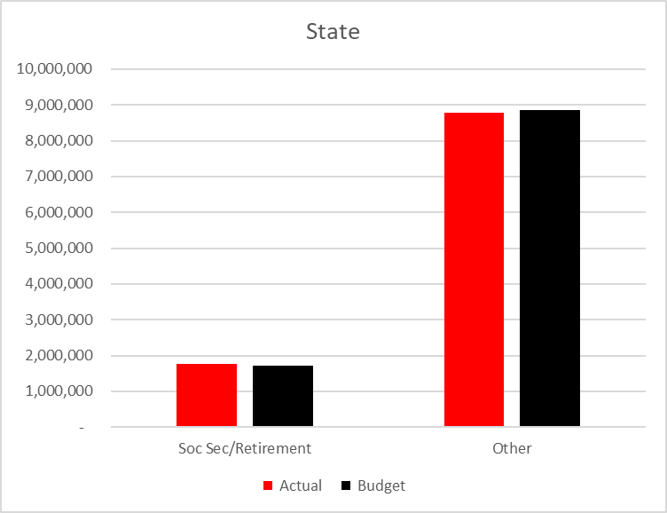
Budget vs Actual
State Revenue

Slide 21
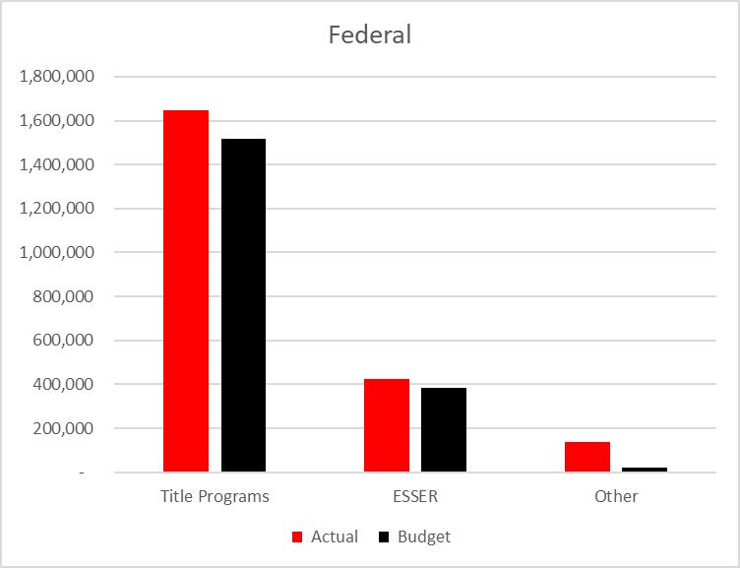
Budget vs Actual
Federal Revenue

Slide 22
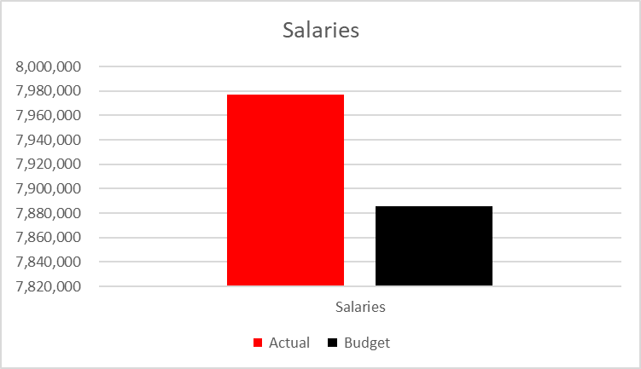
Budget vs Actual
Salaries

Slide 23
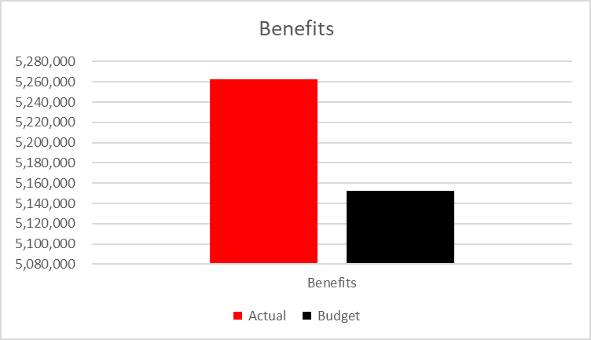
Budget vs Actual
Benefits

Slide 24
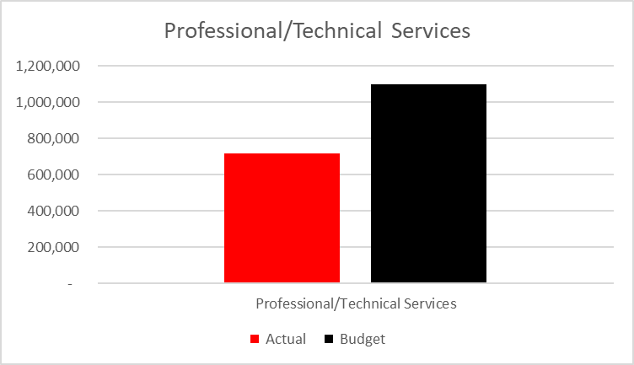
Budget vs Actual
Professional/Technical Services

Slide 25
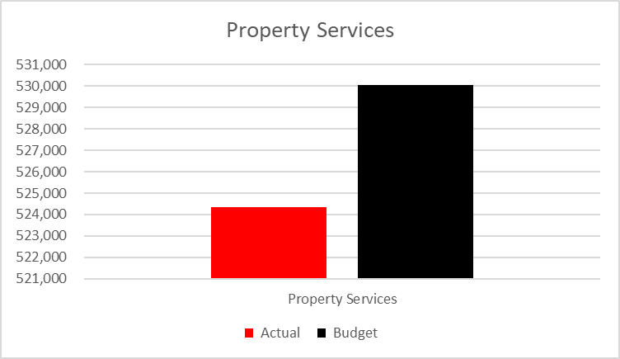
Budget vs Actual
Property Services

Slide 26
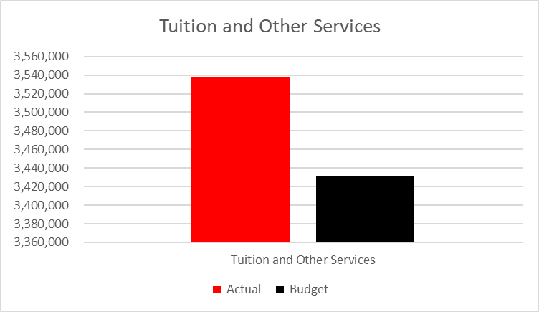
Budget vs Actual
Tuition and Other Services

Slide 27

Budget vs Actual
Supplies

Slide 28
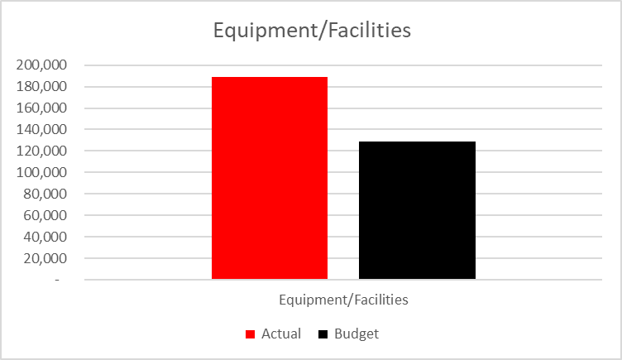
Budget vs Actual
Equipment/Facilities

Slide 29
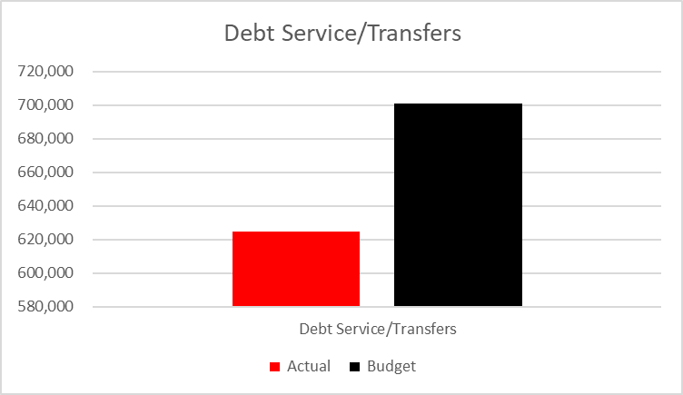
Budget vs Actual
Debt Service/Transfers

Slide 30
Suggestions for Improvements

Slide 31
Items to Note
Material Weakness
  1) Segregation of Duties

Slide 32

We would like to personally thank the entire staff for their help and cooperation in performing this year’s audit. We appreciate the relationship we have developed with the District.

